Slide 1
Fibonnaci Sequence Generator and Testbench in VHDL
Michael Larson

Slide 2
Fibonnaci Sequence
1,1,2,3,5,8,…
Each output is the sum of the two previous outputs
reset: 1
reset: 0
A
B
C
clk
clk
output
A=B+C
(combinational)

Slide 3
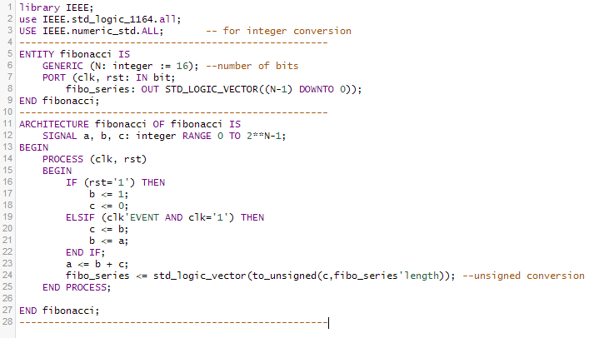
Fibonnaci Sequence Generator in VHDL

Slide 4
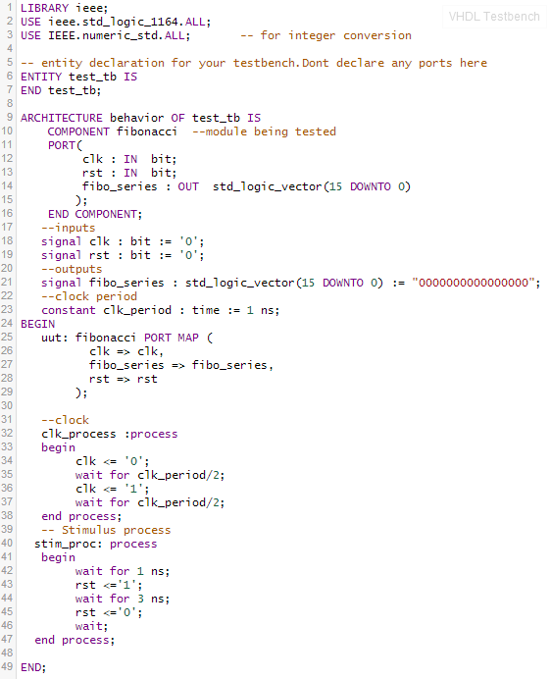
Testbench in VHDL

Slide 5
Output
-After the reset the C output is 0
-On ever falling clock edge C gets a new value shifted in
-The clock input could be a button input with some debouncing logic
-the output is in hexadecimal (1,1,2,3,5,8,d,15,22…)

Slide 6
Examples Used
Fibonnaci Generator: from Digital Electronics and Design with VHDL, Pedroni, 2008
http://booksite.elsevier.com/9780123742704/casestudies/Samples_of_VHDL_codes_presented_in_the_examples.pdf
General Testbench
VHDL RAM example in EDA playground
Clocking Testbench: blog post by VHDL coding tips and tricks
http://vhdlguru.blogspot.com/2010/03/how-to-write-testbench.html

